Slide 1

Diagnostic and therapeutic method for the scoliosis treatment according to the concept of the reflex balance of the spine
Spinal Reflex Balance method
(SRB-method)

Slide 2
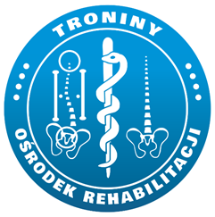

Scoliosis continues to be a challenge for 21st century medicine
Specific prevention of idiopathic scoliosis is not possible because its final cause is yet unknown;
SOSORT scoliosis treatment model:
Early correct diagnosis, observation with rational use of spine X-rays, undertaking therapeutic measures at the initial stage of scoliosis development.
Conservative treatment that is most effective in the team: doctor, physiotherapist, orthopedic technician performed by:
a) specific physiotherapy exercises
b) corset,
c) education,
Objective assessment of treatment results and possible surgical treatment
taking into account the quality-of-life aspect of a person with scoliosis.

Slide 3
Diagnostic and therapeutic method
Spinal Reflex Balance method
SRB method
SRB - is a proposal of comprehensive orthopedic care for a child with risk of developing idiopathic scoliosis.
SRB method - includes a diagnostic and therapeutic proposal
SRB method
Diagnostic
Therapy

Slide 4
SRB – diagnostic part
The diagnostic part includes a model of body posture examination, which is not only limited to the early detection of scoliosis, but also includes the assessment of posture parameters responsible for proper development of the musculo-skeletal system
There are analyzed only measurable parameters (for example by scoliometer or inclinometer), which are importand for proper child development
On the basis of the test results, the child is classified into one of the four groups determining the severity of postural deformity.
Groups 1 to 4 contain specific parameter criteria and guidelines for therapeutic management, taking into account the child's age and gender.

Slide 5
Features of good conservative treatment
Auto three-plane correction,
Posture correction
Posture stabilization
Daily physical activity training,
Patient education
Scoliosis . “Rehabilitation schools for scoliosis” thematicseries: describing the methods and results
Manuel D Rigo1*, Theodoros B Grivas2

Slide 6
Patophysiology of scoliosis according to SRB
as a result of torsional forces in scoliosis, changes occur and gradually consolidate. Initially these are functional, functional, in muscles, ligaments, fasciae, and then functional in the vertebrae
complex deformities of the spine alter the growth of the cartilage of the vertebrae and the vertebrae gradually become permanently distorted
Canavese F, Dimeglio A, Granier M, at al. Arthrodesis of the first six dorsal vertebre in prepubertal New Zealand White rabbits and thoracic growth to skeletal maturity: the role of the “Rib-Vertebral-Sternal complex” Minerva Ortopedica e Traumatologica 2007 October;58(5):369-77

Slide 7
SRB method
Diagnostic
Terapy
1. back assymetry
2. Lumbar lordosis and
thorasic kyphosis
angle
3. Functional lenght of lower
extremities
4. Static of knee and ankle
joints
Group I
Group II
Group III
Group IV

Slide 8
method SRB
Diagnostics
Therapy
I rule - static-dynamic balance of pelvic girdle
II rule – three-plane spine correction and optimization of functional posture.
III rule - balancing of afferent and efferent stimulus from proprioceptors and paraspinal mechanoreceptors
IV rule - passive-active corrective influence
(orthopedic corset, GraviSpine)
V rule - forming the habit of corrected position
in everyday activities

Slide 9
1. Gravispine works by stretching the contracted capsule and muscular ligament structures on the side of the concave curvature in the mechanism of three-plane correction in the environment of gravitational relief on the intervertebral joints and intervertebral discs.
The effect of Gravispine action on the contracted structures of the spine breaks the vicious circle, so breaks the scoliosis factors
Regardless of the nature and origin of the initial abnormal curvature of the spine in scoliosis, the tripartite deformity causes asymmetrical stress on the vertebrae, imbalance and asymmetrical muscle activity
Hawes M, O’Brien J The transformation of spinal curvature into spinal deformity: pathological processes and implications for treatment. Scoliosis 2016; 1:3
some muscles of the spine are shortened and have greater tension while resting, and some of them are elongated with reduced strength. This imbalance affects the reaction of the interaction of forces between the vertebrae and causes further deformations in their anatomical structure.
Stokes IA, Burwell RG, Dangerfield PH, IBSE. Biomechanical spinal growth modulation and progressive adolescent scoliosis--a test of the 'vicious cycle' pathogenetic hypothesis: summary of an electronic focus group debate of the IBSE Scoliosis 2006; 1:16

Slide 10
2. Gravispine causes derotation effect on the vertebrae through a targeted action of side pelots to the peak of scoliosis and spine elongation.
This inversion position with the head downwards with the fixation point on the level of lower limbs decreases the rotation, after the streching forces in the cranial direction occur (from sacrum to cranial)
Little, JP, Izatt MT, Labrom RD, Askin GN, Adam CJ Investigating the change in three dimensional deformity for idiopathic scoliosis using axially loaded MRI. Clinical Biomechanics Volume 27, Issue 5, June 2012, Pages 415-421
Adam CJ, Askin GN, Pearcy MJ Gravity-induced torque and intravertebral rotation in idiopathic scoliosis. Spine 2008 Jan 15;33(2):E30-7

Slide 11
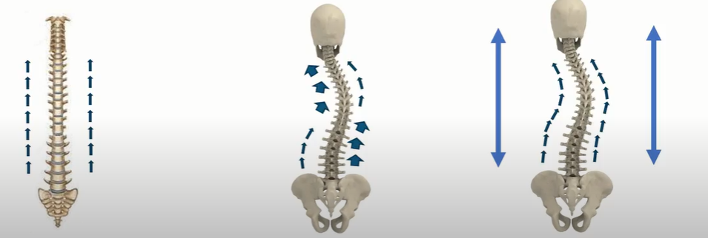
3. Gravispine counteracts the disharmony of postural stimuli of the reflex arches at the level of the brain and / or the core responsible for the formation of scoliosis by activating mechanoreceptors and proprioreceptors in the contracted perivertebral structures on the concave side of the curvature
Balance of afferent stimuli from spine short muscle postural receptors
Lack of balance of afferent stimuli from spine short muscle postural receptors
Restoring balance of afferent stimuli with GraviSpine

Slide 12
4. Action of GraviSpine combined with the performance of breathing exercises (biofeedback) activates the postural deep muscles responsible for the axial alignment of the spine
Trial used modeling of deep back muscles activation and the impact of external force in scoliosis. The potential of muscle activation and external strength was investigated in 5 types of scoliosis according to King.
For small scoliosiss (Cobb, 20 degrees) for scoliosis type 5 acc. to King, it was possible to reduce the curve value by 85%, and for type 4 by 75%, for types 2 and 1 by 60%. The reduction of curvature was smaller with greater Cobb angles.
After muscle activation and the application of external force, it has been shown that for a good result there should be interaction of both activities. The combination resulted in the need for a lower level of muscle mobilization or less external force than if they were applied to the spine separately.
Curtin M, Lowery MM, Musculoskeletal modelling of muscle activation and applied external forces for the correction of scoliosis Journal of NeuroEngineering and Rehabilitation 11(1):52

Slide 13
5. GraviSpine aligns the support plane for the spine proper development by correcting the oblique pelvis in case of functional abbreviations of the limbs (children with hip dysplasia and postural asymmetry in the neonatal period).
The author of below article confirms the concept of using GraviSpine in order to summarize the load on the last lumbar vertebra assuming the position of the pelvis with S1, stating that:
Gravity-induced torque is the likely cause of intravertebral rotation in progressive idiopathic scoliosis
Spine in scoliosis is deformed in three dimensions, so in order to generate appropriate torques, the rotation of the vertebrae should occur after the initial lateral flection, which suggests that the lateral curvature precedes the rotation of the vertebrae in progressive idiopathic scoliosis
Gravispine use this effect by suspending the leg functionally shorter in order to stretch the contracted structures (pelvic ligaments, hamstring muscles) in order to symmetrize the connection of the pelvis with the spine
Adam CJ, Askin GN, Pearcy MJ Gravity-induced torque and intravertebral rotation
in idiopathic scoliosis. Spine 2008 Jan 15;33(2):E30-7

Slide 14
Initial evaluation of the effectiveness of the Spine Reflex Balance-(SRB) algorithm
The study material consists of 830 children and adolescents aged 6-17 years, mean age -11.54 (SD ± 3.05) treated at the center in 2011-2017.
The children were referred from pediatric and orthopedic clinics and family doctors.
Qualification for the treatment of postural defects and scoliosis was carried out according to the developed 4 group diagnostic model ROK, considering the SOSORT recommendations.
The mean duration of treatment and follow-up was 29.88 (SD ± 7.05) months.
The same diagnostic and therapeutic algorithm was used in all children.

Slide 15
Characteristics of patients
VARIABLE | Parameter | Total (N=830) | RTG (N=275) | NO X-RAY (N=555) | TEST | p-value
AGE [years] | N | 830 | 275 | 555 | U Mann-Whitney | <0,001
 | Avarage (SD) | 10,65 (3,15) | 11,25 (3,08) | 10,35 (3,14)
 | Median (IQR) | 10 (8 - 13) | 11 (9 - 14) | 10 (8 - 13)
 | Range | 6 - 17 | 6 - 17 | 6 - 17
AGE [years range] | 6-9 | 40,7% (N=338) | 30,2% (N=83) | 45,9% (N=255) | chi-square | <0,001
 | 10-12 | 27,1% (N=225) | 30,9% (N=85) | 25,2% (N=140)
 | 13-17 | 32,2% (N=267) | 38,9% (N=107) | 28,8% (N=160)
SEX | GIRLS | 65,3% (N=542) | 80,7% (N=222) | 57,7% (N=320) | chi-square | <0,001
 | BOYS | 34,7% (N=288) | 19,3% (N=53) | 42,3% (N=235)
Zmienna | Parametr | Ogółem (N=830) | RTG (N=275) | Brak RTG (N=555) | test | p-value
Wiek [lata] | N | 830 | 275 | 555 | U Mann-Whitney | <0,001
 | Średnia (SD) | 10,65 (3,15) | 11,25 (3,08) | 10,35 (3,14)
 | Mediana (IQR) | 10 (8 - 13) | 11 (9 - 14) | 10 (8 - 13)
 | Zakres | 6 - 17 | 6 - 17 | 6 - 17
Wiek podział [lata] | 6-9 | 40,7% (N=338) | 30,2% (N=83) | 45,9% (N=255) | chi-kwadrat | <0,001
 | 10-12 | 27,1% (N=225) | 30,9% (N=85) | 25,2% (N=140)
 | 13-17 | 32,2% (N=267) | 38,9% (N=107) | 28,8% (N=160)
Płeć | Dziewczyny | 65,3% (N=542) | 80,7% (N=222) | 57,7% (N=320) | chi-kwadrat | <0,001
 | Chłopcy | 34,7% (N=288) | 19,3% (N=53) | 42,3% (N=235)

Slide 16
ATR angle change before and after the therapy
(difference criterion ≥ 2 ° )
 | Parameter | Th-L Spine | L Spine | Th Spine | C-Th Spine
ATR CHANGE [°] | N | 402 | 274 | 354 | 10
 | AVERAGE (SD) | -1,18 (2,07) | -0,76 (2,54) | -0,57 (2,18) | -0,4 (1,51)
 | Median (IQR) | -1 (-2 - 0) | -1 (-2 - 0) | -1 (-2 - 0) | 0 (0 - 0)
 | RANGE | -13 - 7 | -9 - 17 | -10 - 11 | -4 - 1
ATR CHANGE [categories] | NO CHANGE | 18,9% (N=76) | 26,6% (N=73) | 24,6% (N=87) | 60% (N=6)
 | DETERIORATION | 17,2% (N=69) | 17,5% (N=48) | 24% (N=85) | 20% (N=2)
 | IMPROVEMENT | 63,9% (N=257) | 55,8% (N=153) | 51,4% (N=182) | 20% (N=2)

Slide 17
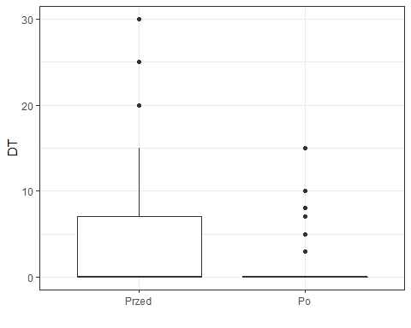
Change in the difference in the functional length of the lower limbs before and after treatment
(3 mm difference criterion)
FISHER TEST <0,001

Slide 18
Change in the size of the Cobb angle on X-ray before and after treatment
(criterion of difference ≥ 2 ° according to Cobb)
 | Parameter | Spine Th-L | Spine L | Spine Th | Spine C-Th
Scoliosis angle: Cobb group 10-67 ° (average: 22.4 °) Cobba angle change at X-ray [°] Within range 2-17 ° | N | 58 | 108 | 109 | -
 | AVERAGE (SD) | -1,72 (6,4) | 0,3 (9,42) | -1,03 (9,39) | -
 | Median (IQR) | -2,5 (-5 - 2,75) | 1 (-4,75 - 5) | -2 (-6,5 - 4) | -
 | Range | 2 - 15 | 2 - 17 | 2 - 13 | -
X-ray chagnes [categories] | NO CHANGE | 0% (N=0) | 2,6% (N=3) | 7,6% (N=8) | -
 | DETERIORATION | 28,6% (N=17) | 51,3% (N=55) | 38% (N=42) | -
 | IMPROVEMENT | 71,4% (N=41) | 46,2% (N=50) | 54,4% (N=59) | -

Slide 19
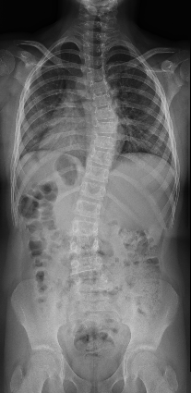
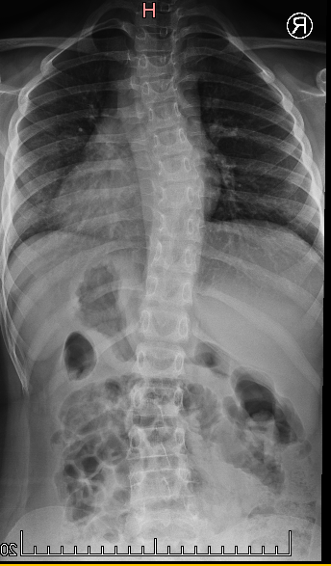
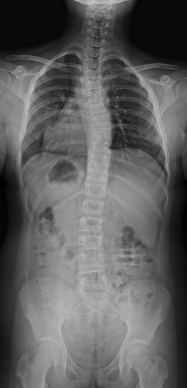
Case study: Milena, 10 years
2019
2020
2021
Milena, birth date 03.2011 r.
Star of treatment: 2019 (age: 8 years)
Cobb angle:
at 2019:
Th dex 25ᵒ, L sin 23ᵒ.
at 2020:
Th dex 22ᵒ, L sin 13ᵒ.
2021:
Th dex 15ᵒ. L sin 12ᵒ

Slide 20

GKS GRAVISPINE
product
medical device

Slide 21
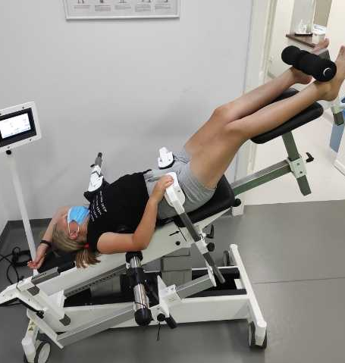
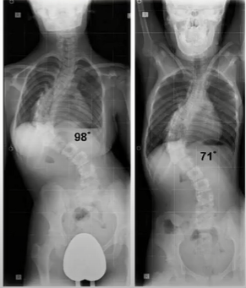
Treatment with the Scoliosis Gravity Corrector, patent no. PL 222124

Slide 22
Element of each method of work with scoliosis
Schroth
FITS
Dobomed (pl)
PNF
every scoliosis therapy method

Slide 23
Brochure
Webinar
Presentation
Therapist / product manager
CONGRESSes (dedicated to children and scoliosis)
Athens, September 2022

