Slide 1



Antigravity device for therapy of scoliosis
GraviSpine
Marek Kluszczyński PhD
1. Faculty of Health Science University in Częstochowa.
2. Ośrodek Rehabilitacji Leczniczej „ Troniny ” w Kłobucku.
Bogusława Łysakowska-Będek, PT, O
X-Rehab Rehabilitation Center Gliwice
PHU TECHNOMEX sp. z o.o.

Slide 2
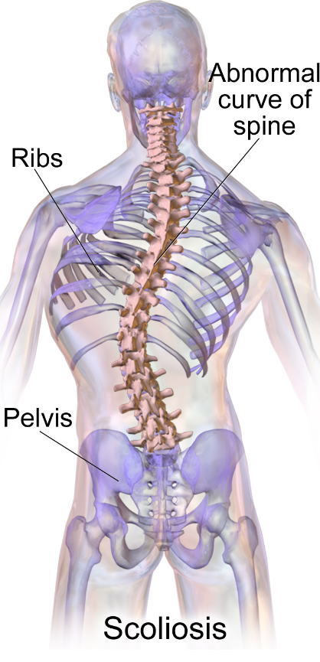
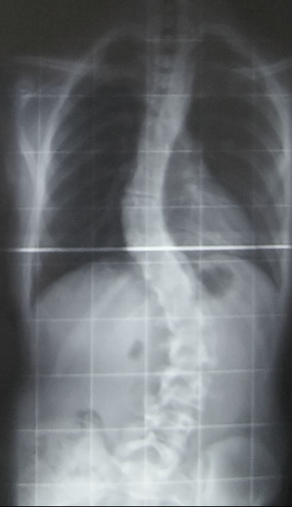

Scoliosis continues to be a challenge for 21st century medicine

Slide 3
Scoliosis continues to be a challenge for 21st century medicine
Specific prevention of idiopathic scoliosis is not possible because its final cause is yet unknown;
SOSORT scoliosis treatment model:
Early correct diagnosis, observation with rational use of spine X-rays, undertaking therapeutic measures at the initial stage of scoliosis development
Conservative treatment that is most effective in the team: doctor, physiotherapist, orthopedic technician performed by:
a) specific physiotherapy exercises
b) braces,
c) education,
Objective assessment of treatment results and possible surgical treatment
taking into account the quality-of-life aspect of a person with scoliosis

Slide 4
Features of good conservative treatment
three-plane correction
auto posture correction
posture stabilization
daily physical activity training
patient education
Scoliosis . “Rehabilitation schools for scoliosis” thematicseries: describing the methods and results
Manuel D Rigo1*, Theodoros B Grivas2

Slide 5
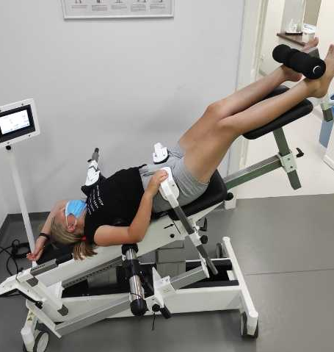
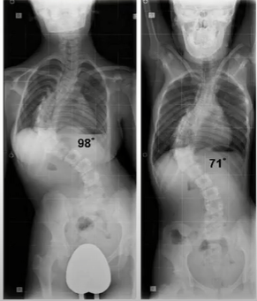
GraviSpine Treatment with the Scoliosis Gravity Corrector, patent no. PL 222124 (GKS)

Slide 6
Application:
as a part of children and adolescents scoliosis treatment,
functional asymmetries of the the posture
adult patients with scoliosis to improve the comfort of everyday life
Scheuermann's Disease
From aprox. 3-4 years old

Slide 7
Application:
In the treatment of spine pain syndromes at the level of Th and L-S of adults and adolescents
Inflammatory conditions of intervertebral discs and vertebrae of adults and adolescents
preparation for surgical procedures of scoliosis (and others)
Age: children and adults

Slide 8
How GraviSpine works
Thanks to the horizontal positioning and stabilization of the pelvis (in the transverse, sagittal and frontal plane), we eliminate decompensation of the spine in the sections above and below the curvature

Slide 9
How GraviSpine works
1. Stabilisation and antigravity position - correction of the spine by elongation and derotation

Slide 10
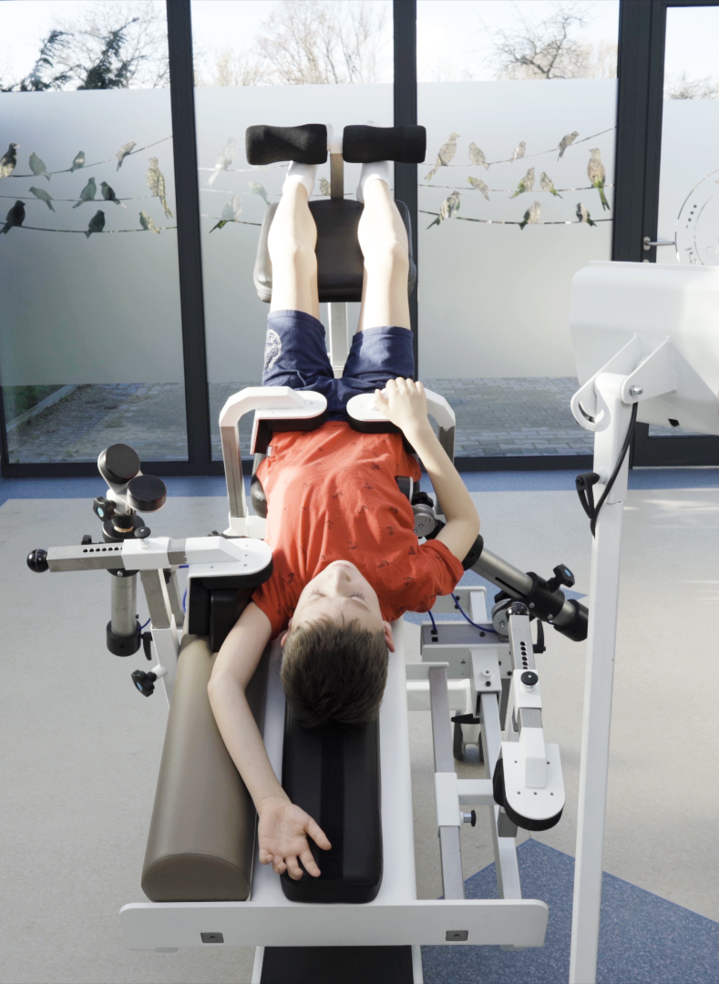
How GraviSpine works
Thanks to the antigravity position (head down up to 30⁰), we gain an elongation of the spine
achieved effect contributes to the muscle relaxation, relief of intervertebral joints and intervertebral spaces (intervertebral discs)

Slide 11
How GraviSpine works
decompression of the intervertebral joints facilitates lateral correction and derotation of the curvature of the spine - it creates convenient conditions for correcting scoliosis without the use of pressure

Slide 12
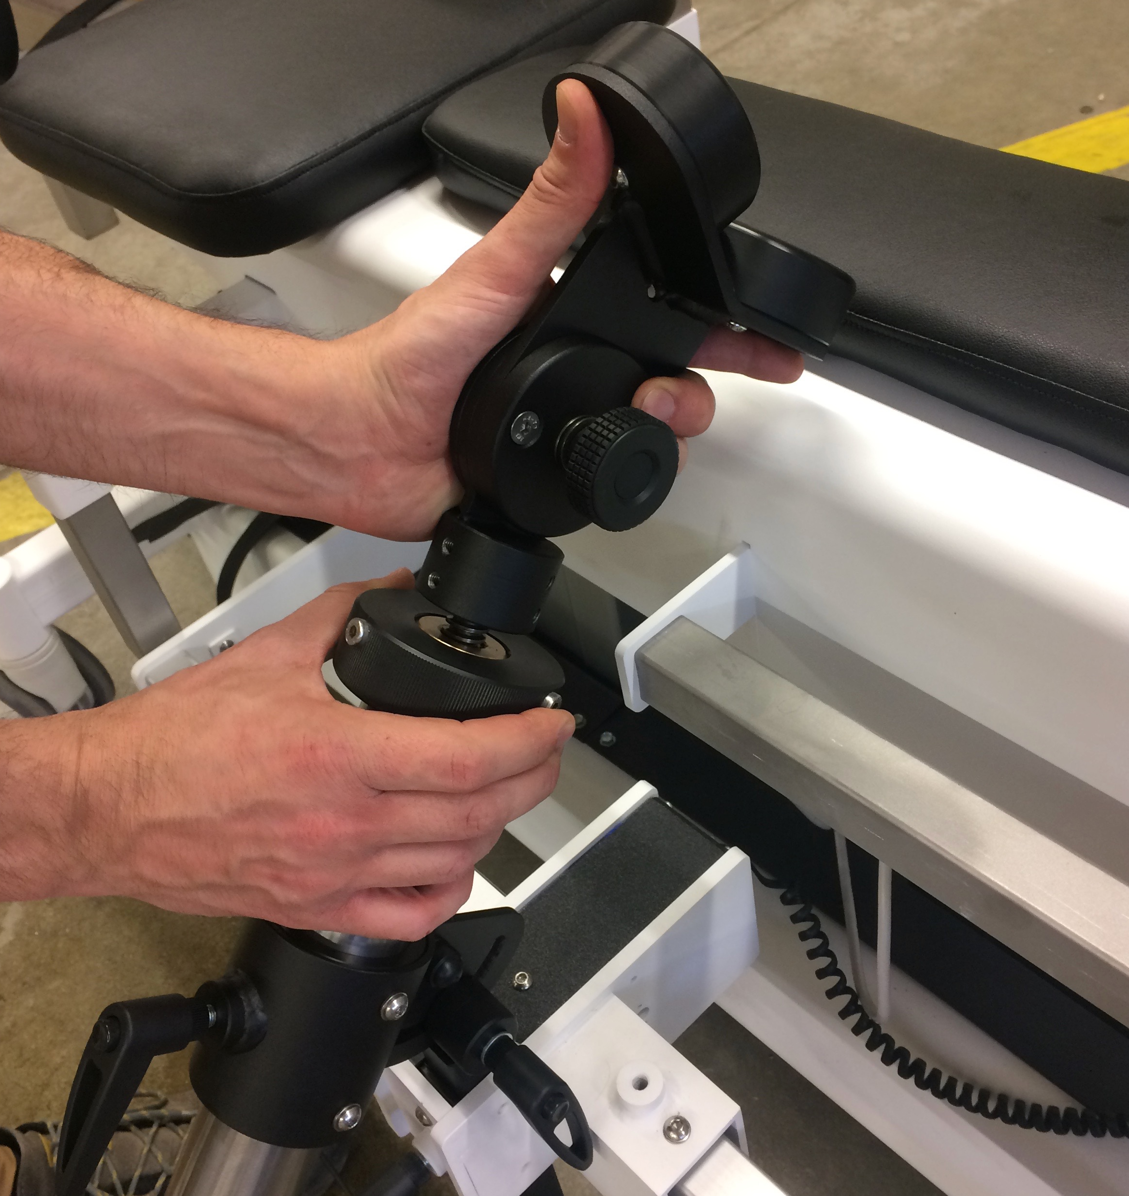
GraviSpine
2. 3-plane mechanical correction of pathological curvature of the spine

Slide 13
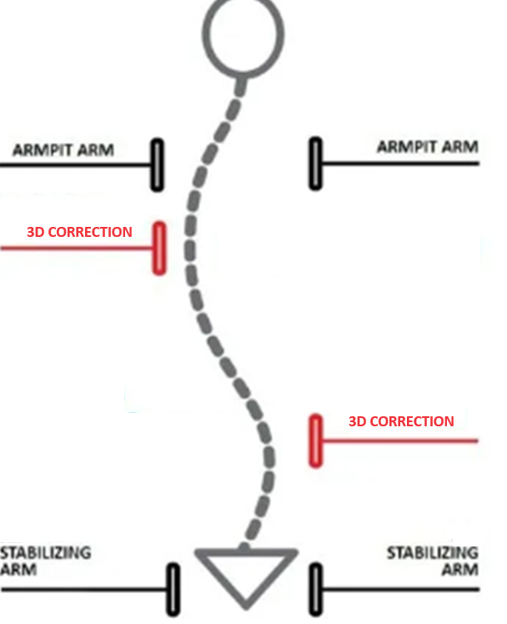
GraviSpine
3-plane mechanical correction

Slide 14
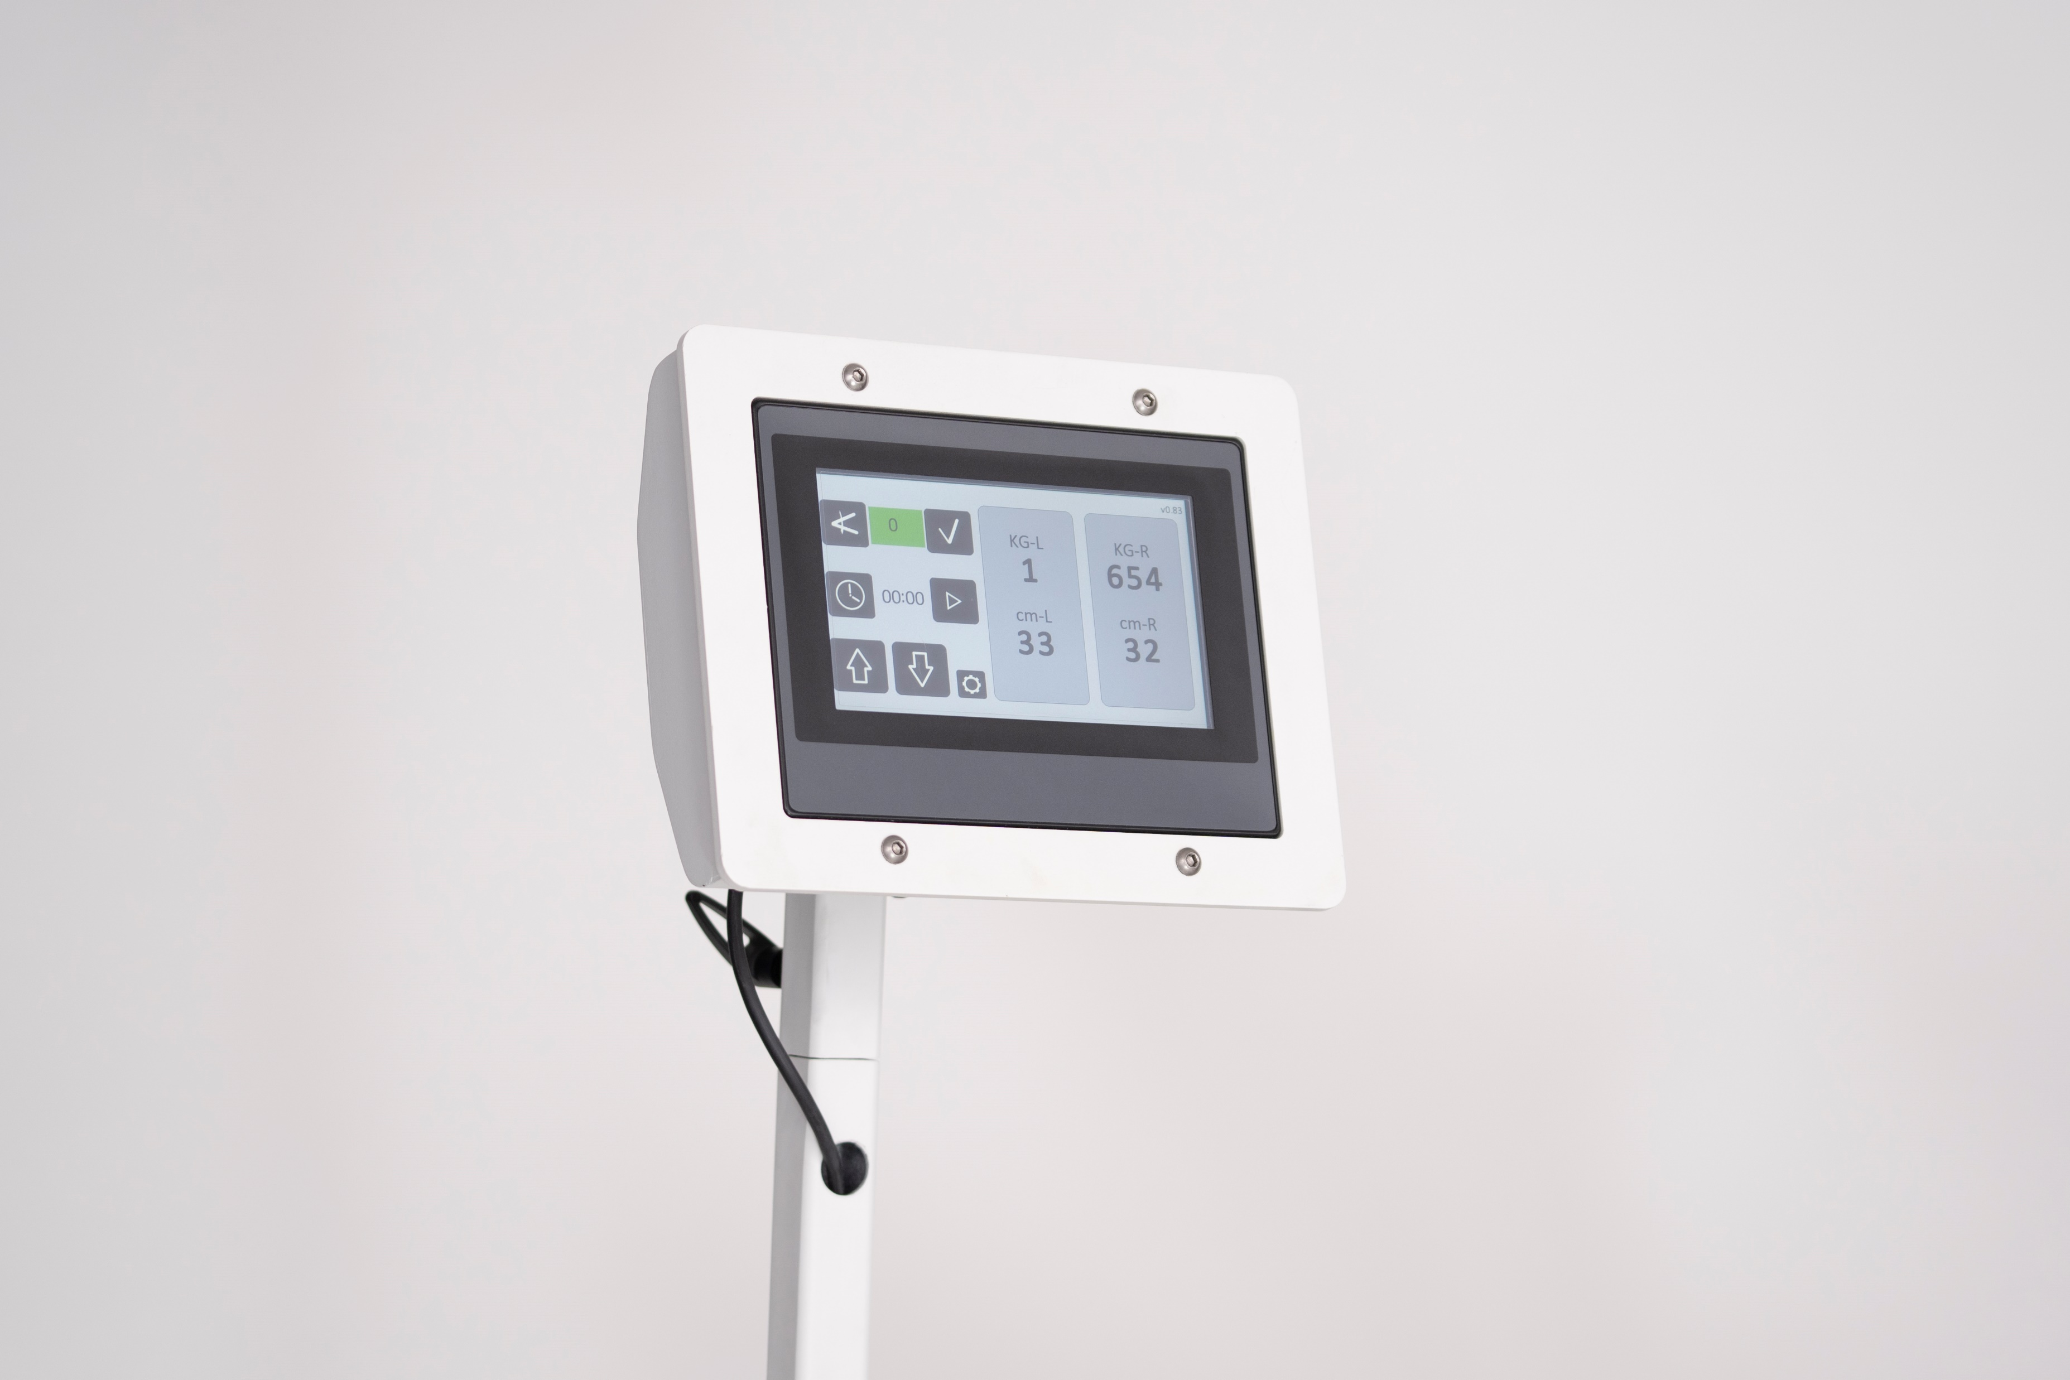
How GraviSpine works
3. Breathing exercises with biofeedback
Patient, under the control of the physiotherapist, performs a slow inhalation „to” the concave side of the curvature, observing a decrease in the value of the pressure of the compression pad on the convex side of the curve (usually 2-3 kg)

Slide 15
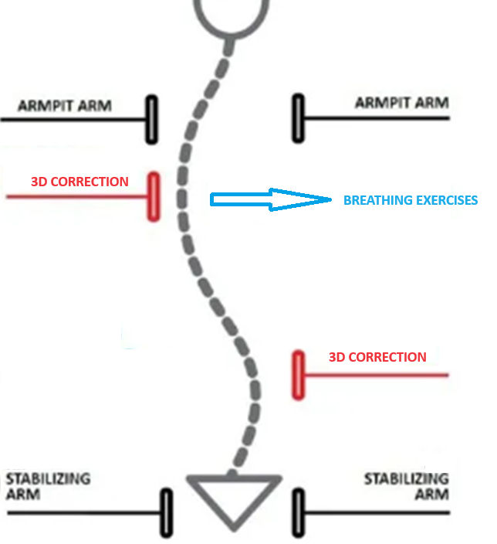
How GraviSpine works
3. Breathing exercises with biofeedback

Slide 16
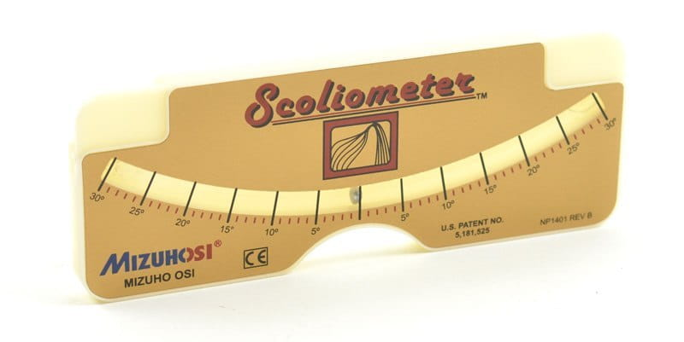
How GraviSpine works
Find and measure apex of scoliosis
Before each procedure, the asymmetry of the back is evaluated, marking the top of the curvature on the trunk with a marker for precise placement of corrective pads

Slide 17

How GraviSpine works
2. Set up parameters on the screen,
you can accurately, manually dose the corrective force of the lateral pads, individually adjusting the pressure to the patient's feelings (usually the range is 8-20 kg)

Slide 18
How GraviSpine works
3. Set up angle of antigravity position
inclination angle of the table allows you to obtain an anti-gravity decompression on the spine at any angle change intervals
Set up time (2-10 minutes)

Slide 19
How GraviSpine works
5. Check and corect pressure to the initial values and patients sensations.
During the time because of tissues relaxation and elongation of the spine, you will observe a decrease in the previous values of the pads pressure

Slide 20
How GraviSpine works
6. Breathing exercises with biofeedback
Patient, under the control of the physiotherapist, performs a slow inhalation „to” the concave side of the curvature, observing a decrease in the value of the pressure of the compression pad on the convex side of the curve (usually 2-3 kg)

Slide 21
Contraindication
Infectious diseases with impaired functions of the body
Congenital malformations of the osteoarticular system, especially of the spine and lower limbs
Defects and diseases of the nervous system that can affect the musculoskeletal system or the course of the procedure (eg. epilepsy)
Post-traumatic conditions with bone and skeletal effects that may affect the body after the use of GraviSpine (fractures, dislocations and sprains of the spine)

Slide 22
Contraindication
Addictions and/or mental disorders
Malformations and congenital diseases of the cardiovascular system (congenital and acquired heart defects) - after consultation with cardiologist
Vascular malformations of the brain
Cardiovascular diseases - untreated hypertension

Slide 23
Does GraviSpine works?
Effectiveness of the method is confirmed by the documented results of 830 children with scoliosis treated in the rehabilitation center "Troniny" in 2011-2019

Slide 24
Initial evaluation of the effectiveness of the Spine Reflex Balance - (SRB) algorithm
study material consists of 830 children and adolescents aged 6-17 years, mean age -11.54 (SD ± 3.05) treated at the center in 2011-2017
children were referred from pediatric and orthopedic clinics and family doctors
qualification for the treatment of postural defects and scoliosis was carried out according to the developed 4 group diagnostic model SRB, considering the SOSORT recommendations
mean duration of treatment and follow-up was 29.88 (SD ± 7.05) months
There was used the same diagnostic and therapeutic algorithm for all children

Slide 25
Characteristics of patients
VARIABLE | Parameter | Total (N=830) | X-ray (N=275) | NO X-ray (N=555) | TEST | p-value
AGE [years] | N | 830 | 275 | 555 | U Mann-Whitney | <0,001
 | Avarage (SD) | 10,65 (3,15) | 11,25 (3,08) | 10,35 (3,14)
 | Median (IQR) | 10 (8 - 13) | 11 (9 - 14) | 10 (8 - 13)
 | Range | 6 - 17 | 6 - 17 | 6 - 17
AGE [years range] | 6-9 | 40,7% (N=338) | 30,2% (N=83) | 45,9% (N=255) | chi-square | <0,001
 | 10-12 | 27,1% (N=225) | 30,9% (N=85) | 25,2% (N=140)
 | 13-17 | 32,2% (N=267) | 38,9% (N=107) | 28,8% (N=160)
SEX | GIRLS | 65,3% (N=542) | 80,7% (N=222) | 57,7% (N=320) | chi-square | <0,001
 | BOYS | 34,7% (N=288) | 19,3% (N=53) | 42,3% (N=235)
Zmienna | Parametr | Ogółem (N=830) | RTG (N=275) | Brak RTG (N=555) | test | p-value
Wiek [lata] | N | 830 | 275 | 555 | U Mann-Whitney | <0,001
 | Średnia (SD) | 10,65 (3,15) | 11,25 (3,08) | 10,35 (3,14)
 | Mediana (IQR) | 10 (8 - 13) | 11 (9 - 14) | 10 (8 - 13)
 | Zakres | 6 - 17 | 6 - 17 | 6 - 17
Wiek podział [lata] | 6-9 | 40,7% (N=338) | 30,2% (N=83) | 45,9% (N=255) | chi-kwadrat | <0,001
 | 10-12 | 27,1% (N=225) | 30,9% (N=85) | 25,2% (N=140)
 | 13-17 | 32,2% (N=267) | 38,9% (N=107) | 28,8% (N=160)
Płeć | Dziewczyny | 65,3% (N=542) | 80,7% (N=222) | 57,7% (N=320) | chi-kwadrat | <0,001
 | Chłopcy | 34,7% (N=288) | 19,3% (N=53) | 42,3% (N=235)

Slide 26
ATR angle change before and after the therapy
(difference criterion ≥ 2 ° )
 | Parameter | Th-L Spine | L Spine | Th Spine | C-Th Spine
ATR CHANGE [°] | N | 402 | 274 | 354 | 10
 | AVERAGE (SD) | -1,18 (2,07) | -0,76 (2,54) | -0,57 (2,18) | -0,4 (1,51)
 | Median (IQR) | -1 (-2 - 0) | -1 (-2 - 0) | -1 (-2 - 0) | 0 (0 - 0)
 | RANGE | -13 - 7 | -9 - 17 | -10 - 11 | -4 - 1
ATR CHANGE [categories] | NO CHANGE | 18,9% (N=76) | 26,6% (N=73) | 24,6% (N=87) | 60% (N=6)
 | DETERIORATION | 17,2% (N=69) | 17,5% (N=48) | 24% (N=85) | 20% (N=2)
 | IMPROVEMENT | 63,9% (N=257) | 55,8% (N=153) | 51,4% (N=182) | 20% (N=2)

Slide 27
Change in the size of the Cobb angle on X-ray before and after treatment
(criterion of difference ≥ 2 ° according to Cobb)
 | Parameter | Spine Th-L | Spine L | Spine Th | Spine C-Th
Scoliosis angle – acc to Cobb group 10-67 °, average Cobb angle 22.4 ° Cobb angle change at X-ray [°] in range 2-17 ° | N | 58 | 108 | 109 | -
 | Average (SD) | -1,72 (6,4) | 0,3 (9,42) | -1,03 (9,39) | -
 | Median (IQR) | -2,5 (-5 - 2,75) | 1 (-4,75 - 5) | -2 (-6,5 - 4) | -
 | Range | 2 - 15 | 2 - 17 | 2 - 13 | -
X-ray change [categories] | NO CHANGE | 0% (N=0) | 2,6% (N=3) | 7,6% (N=8) | -
 | DETERIORATION | 28,6% (N=17) | 51,3% (N=55) | 38% (N=42) | -
 | IMPROVEMENT | 71,4% (N=41) | 46,2% (N=50) | 54,4% (N=59) | -

Slide 28
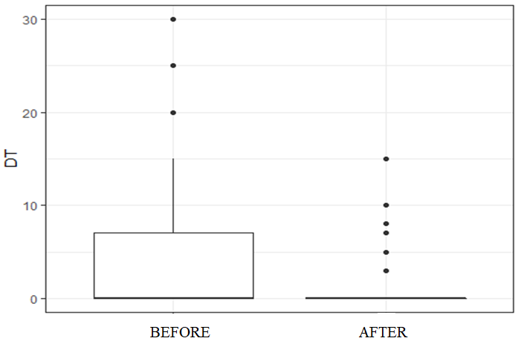
Change in the difference in the functional length of the lower limbs before and after treatment
(3 mm difference criterion)
FISHER TEST <0,001

Slide 29
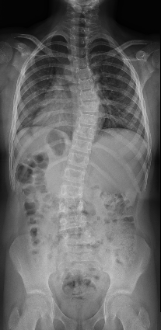
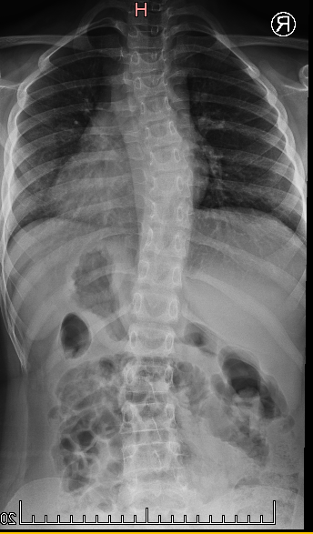
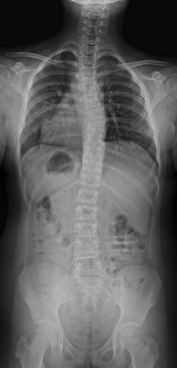
Case study: Milena, 10 years
birth date 03.2011 r.
start of treatment: 2019 (age: 8 years)
Cobb angle:
at 2019:
Th dex 25ᵒ, L sin 23ᵒ.
at 2020:
Th dex 22ᵒ, L sin 13ᵒ.
2021:
Th dex 15ᵒ. L sin 12ᵒ
2019
2020
2021

Slide 30
Diagnostic and therapeutic method
Spinal Reflex Balance method
SRB method
SRB - is a proposal of comprehensive orthopedic care for a child with risk of developing idiopathic scoliosis.
SRB method - includes a diagnostic and therapeutic proposal
SRB method
Diagnostic
Therapy

Slide 31
Advantages of GraviSpine:
effective therapy
device accelerates the treatment of already developed scoliosis, and also inhibits the progression at the stage of scoliosis formation
alternative to other devices
ability to treat more patients
„breath” for therapist
easy transport (four wheels with brake)

Slide 32

PHU TECHNOMEX SP ZOO
UL. SZPARAGOWA 15
44-141 GLIWICE
POLAND
WWW.TECHNOMEX.EU export@technomex.pl
THANK YOU FOR ATTENTION

